Slide 1
Tool Demonstration - FTK Imager
Digital Forensics and Investigation
Lab Continuous Assessment Activity
PA10. Krishnaraj
TY. CSF Panel A

Slide 2
TABLE OF CONTENTS
01
02
03
TOOL
INFORMATION
DEMO
FURTHER INVESTIGATION
Information about the FTK Imager
Live Demo of the Tool
How the investigation will continue.

Slide 3
What is FTKImager
01
Its uses and when it was created.

Slide 4
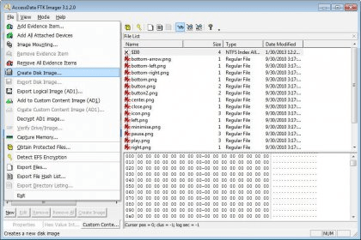
What is it?
FTK Imager is a digital forensic tool.
Developed by AccessData, it's widely used in the field of digital forensics.

Slide 5
Primary Functions
Disk Imaging: FTK Imager is primarily used for creating forensic disk images.
Evidence Preservation: It ensures the preservation of digital evidence by creating exact copies of storage media.
Forensic Analysis: FTK Imager allows investigators to examine disk images for evidence, including files, deleted data, and metadata.

Slide 6
Additional Features
Memory Analysis: Can analyze RAM of a live system, useful in detecting running processes and potential malware.
Hashing and Verification: Supports hashing algorithms to verify the integrity of acquired images.
Export and Reporting: Enables data export and report generation for legal cases and research.

Slide 7
Applications
02
Its uses and when it was created.

Slide 8
Criminal and Corporate Investigations
Criminal Investigations: FTK Imager aids law enforcement in collecting digital evidence from computers, mobile devices, and storage media for cases involving cybercrimes, fraud, and child exploitation.
Corporate Investigations: It helps companies investigate employee misconduct, intellectual property theft, and data breaches, uncovering the source of security breaches and inappropriate activities.

Slide 9
Counterterrorism and Cybersecurity
Counterterrorism: FTK Imager is employed in counterterrorism operations to examine digital devices, uncovering communication networks, plans, and digital evidence related to terrorism.
Cybersecurity Incidents: It analyzes systems in cybersecurity incidents like data breaches and ransomware attacks to identify breach extent and access methods.
Child Exploitation and Cold Cases: FTK Imager plays a pivotal role in child exploitation cases and reopening cold cases by recovering, analyzing, and cataloging digital evidence.

Slide 10
License
03
Its uses and when it was created.

Slide 11
Free for Use
FTK Imager is a free tool provided by AccessData for disk imaging and forensic analysis. It can be freely downloaded and used without cost.
AccessData offers a range of forensic software products, including FTK (Forensic Toolkit) which is a comprehensive solution for digital investigations. However, these products are not free and typically require a license that is priced according to the features and scale needed.

Slide 12
Real Life Uses
04
Its uses and when it was created.

Slide 13
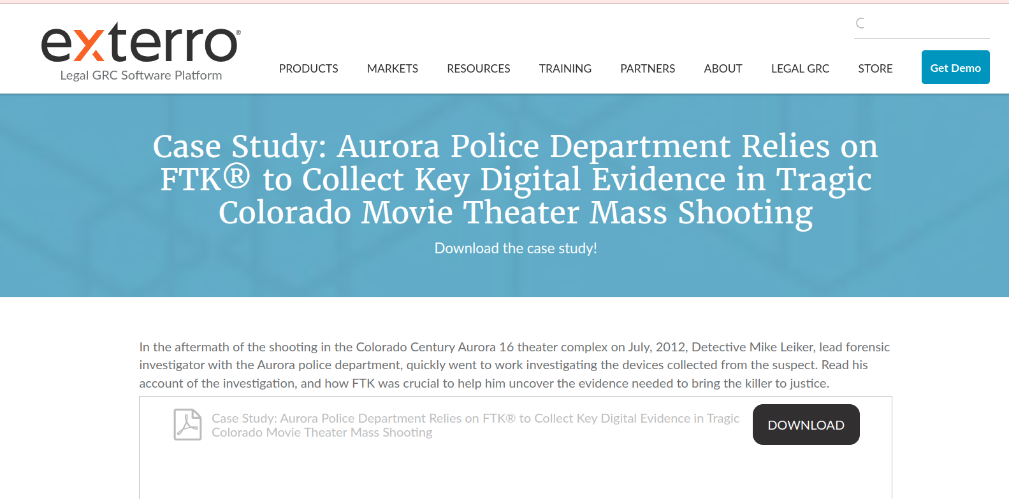

Slide 14
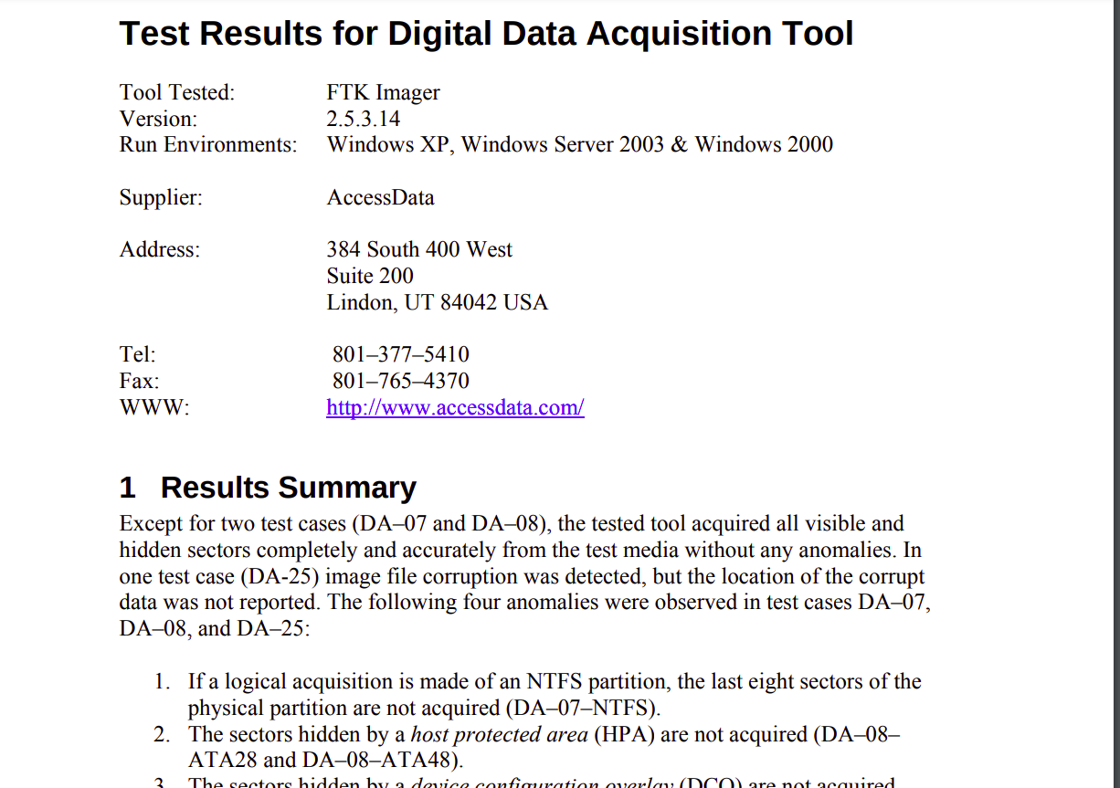

Slide 15
Live Demo
05
Its uses and when it was created.

Slide 16
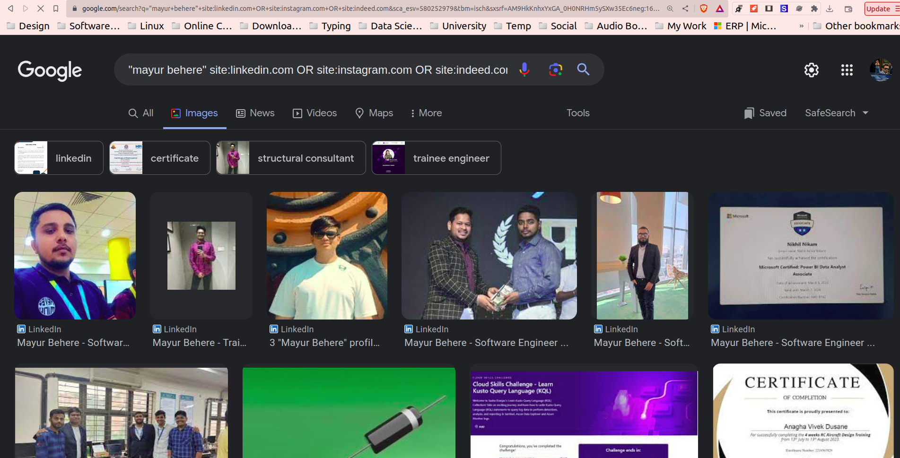

Slide 17
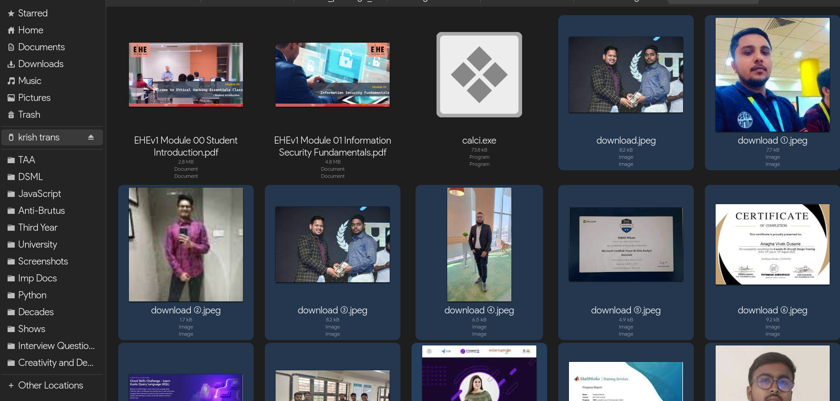

Slide 18
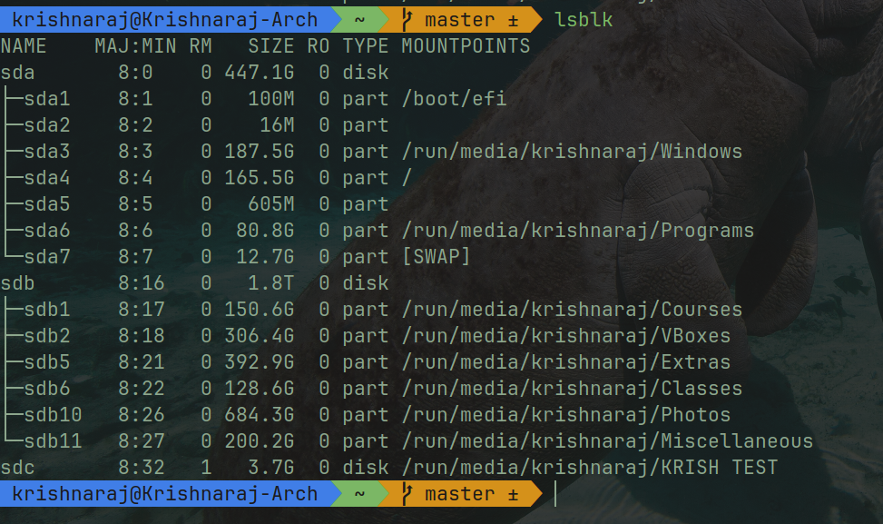

Slide 19
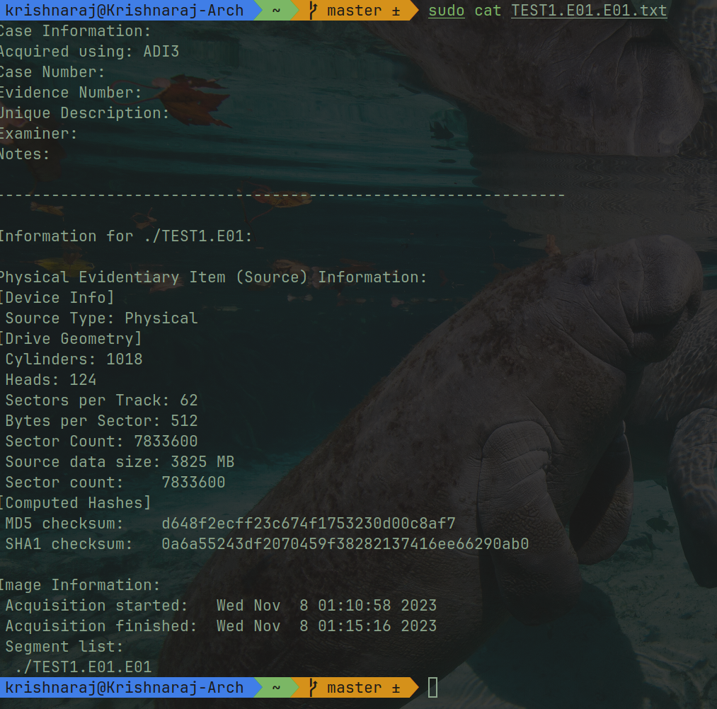

Slide 20
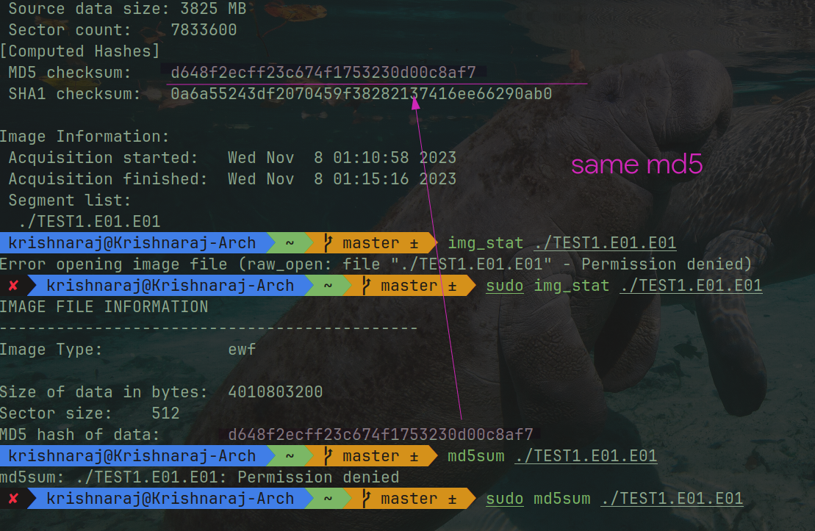

Slide 21
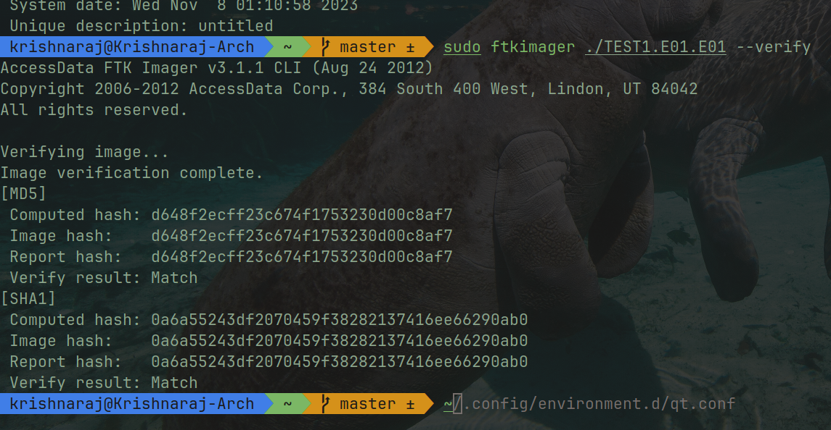

Slide 22
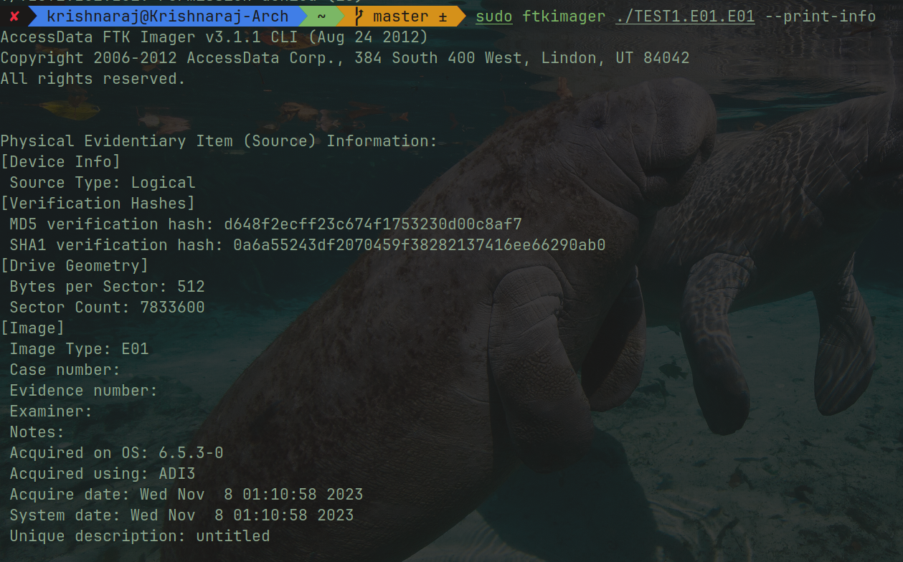

Slide 23
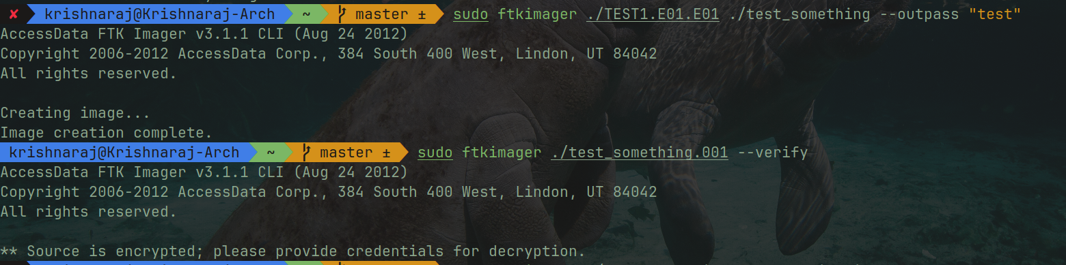

Slide 24
Further Investigation
05
Image file, and its data sent to Parth Zarekar for analysis.

Slide 25
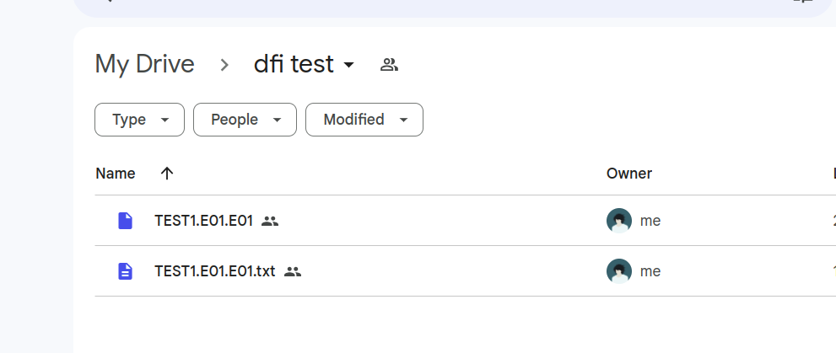

Slide 26
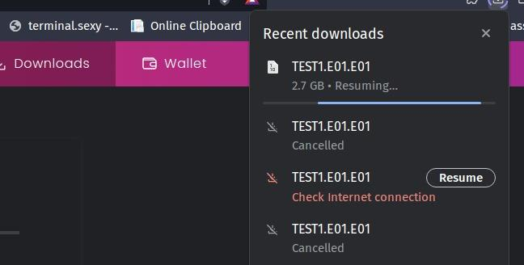

Slide 27
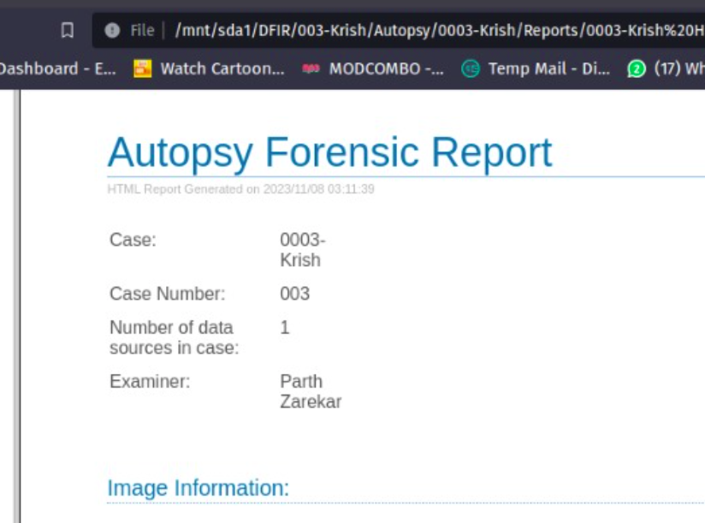

Slide 28
References
Case Study: Aurora Police Department Relies on FTK® to Collect Key Digital Evidence in Tragic Colorado Movie Theater Mass Shooting
Test Results for Digital Data Acquisition Tool: FTK Imager 2.5.3.14

Slide 29
Thank You

